Slide 1

Alkenes
Naming, Properties, reactivity and isomers

Slide 2

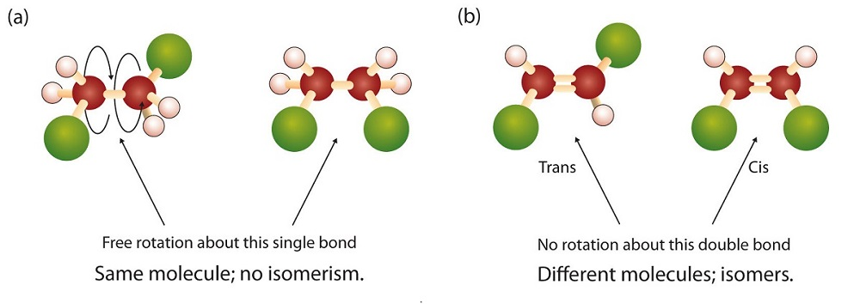
Alkenes - introduction
Alkenes are unsaturated hydrocarbons (contain single bonds and double bonds)
General formula:
C_{n}H_{2n}
Alkenes can be Straight or Branched chains
Single bonds can freely rotate but Double bonds cannot

Slide 3
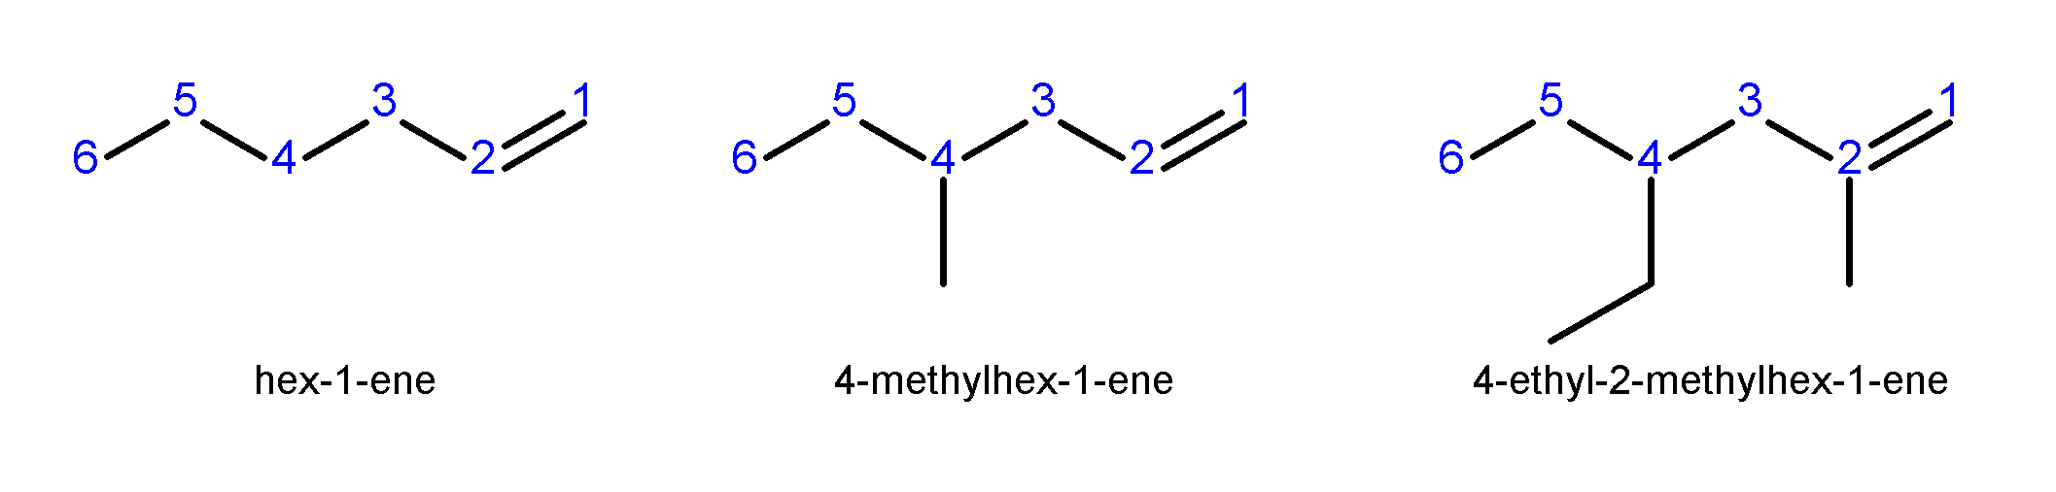
Alkenes - naming
Select the longest continuous chain of carbon atoms that contains the double bond
For an alkene, the stem name of the carbon chain is the same as an alkane, except the ending, the suffix, is now –ene
Number the parent chain starting at the end closest to the double bond
Substituents on the parent chain are treated the same way as naming in alkanes

Slide 4
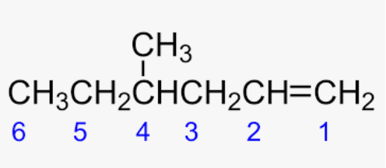
Alkenes - naming
Note: use number to indicate the position of the double bond, this number can be placed either:
In front of the “main chain” name e.g. 4-methyl-1-hexene
Or in front of the –ene suffix e.g. 4 – methylhex-1-ene

Slide 5
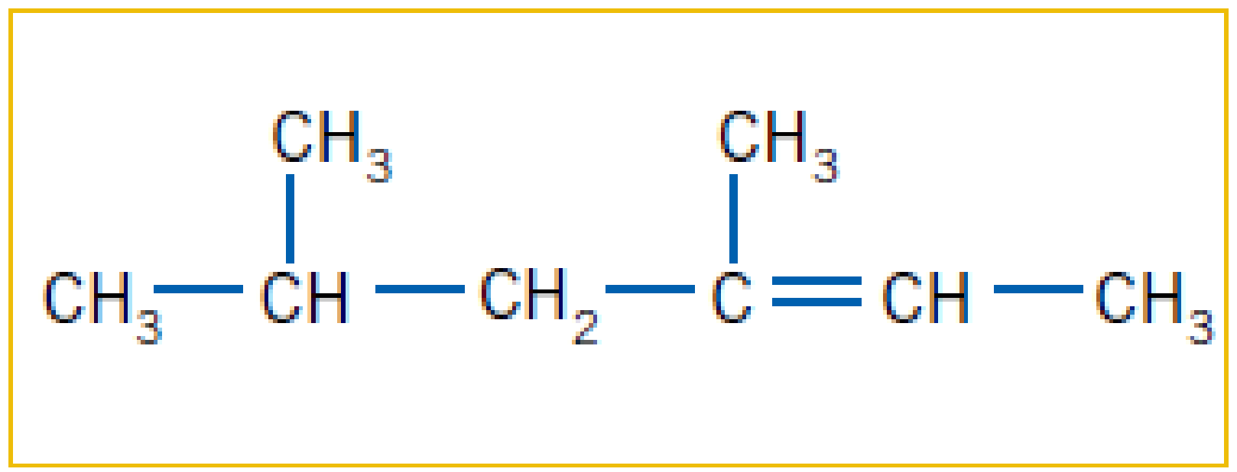
Alkenes - naming
Name the following alkene:
3,5-dimethylhex-2-ene
Write structural formulae for
2,3-dimethylpent-2-ene
4,4,4-tribromo-2-ethyl-3-methylbut-1-ene

Slide 6

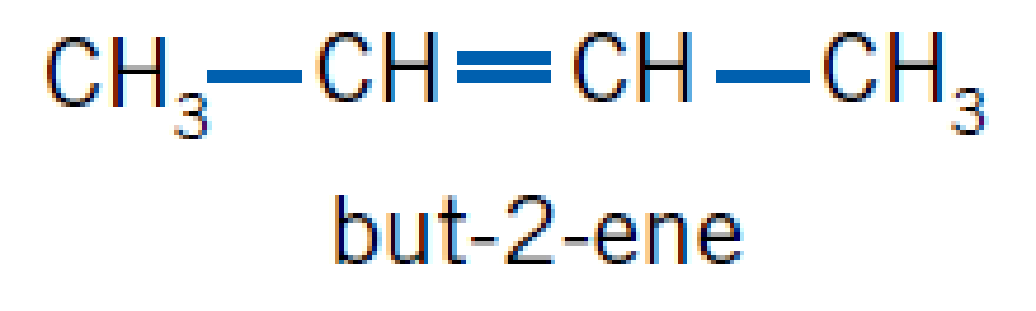
Alkenes - isomers
Molecules can have the same molecular formula but a different structural formula
Position isomers – have same molecular formula but position of the double bond changes

Slide 7
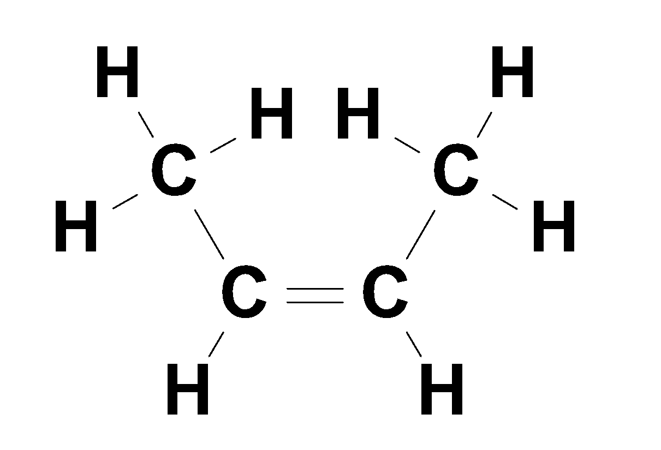
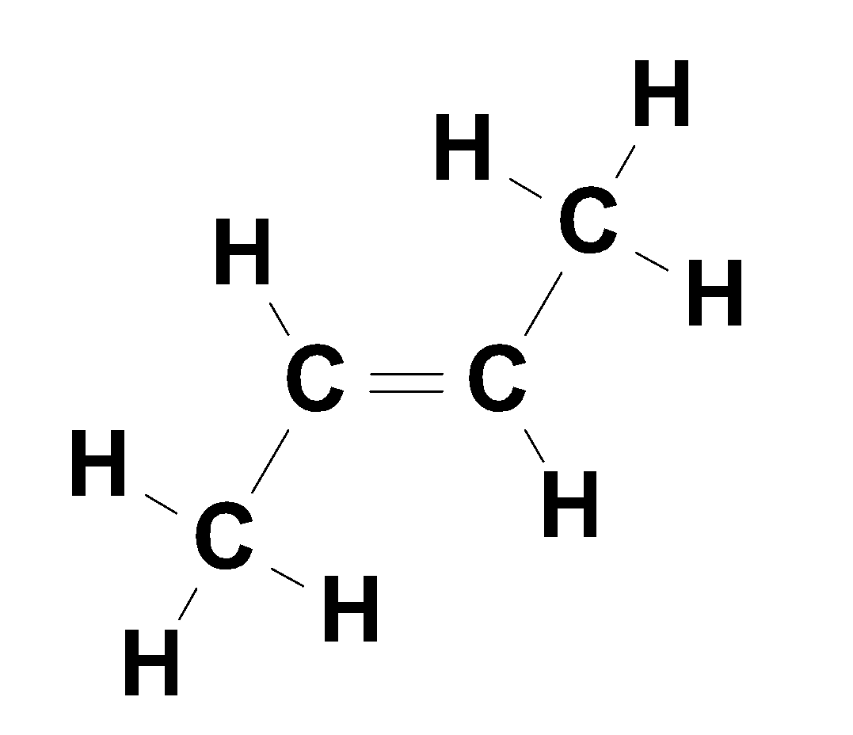
Alkenes - isomers
Molecules can have the same molecular formula but a different structural formula
Position isomers – have same molecular formula but position of the double bond changes
Geometric isomers – due to the double bond not being able to rotate
trans-but-2-ene
Cis-but-2-ene

Slide 8
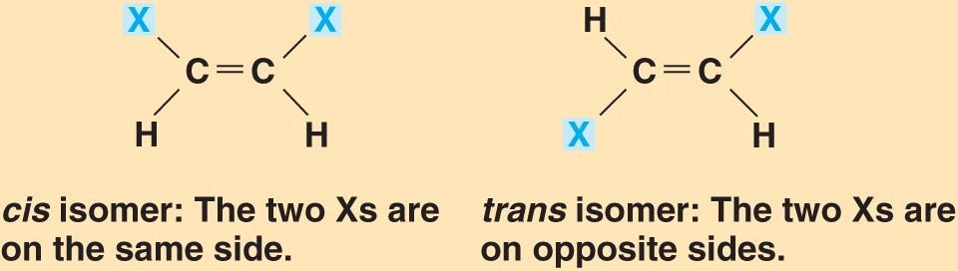

Alkenes – geometric isomers
Some alkenes have the same molecular formula and the same structural formula but different geometries around the double bond
Geometric isomers are called:
Cis- when the two groups are on the same side
Trans- when the two groups are on opposite sides
If either carbon has two groups the same, geometric isomers are not possible
No cis/trans isomers

Slide 9
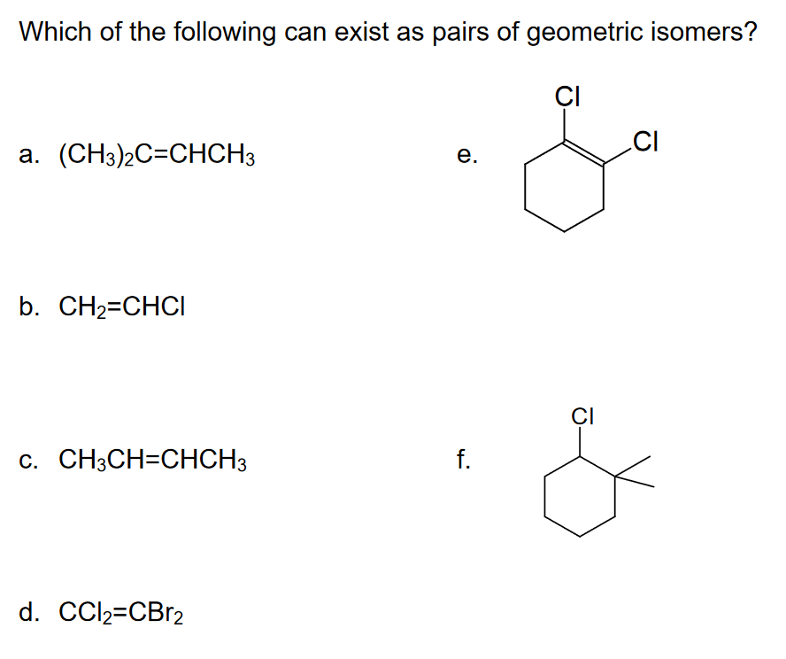
Alkenes – geometric isomers

Slide 10
Alkenes – geometric isomers
No – ring structure forces groups to cis position
No – one C has two groups the same
No – one C has two groups the same
No – doesn’t contain a double bond
Yes
No – one C has two groups the same

Slide 11
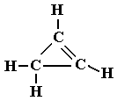
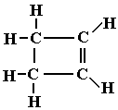
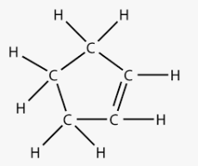
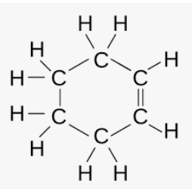
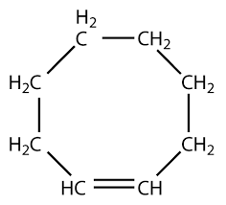
Alkenes – cylic alkenes
Cycloalkene use the same number principles as aliphatic alkenes
General formula: C_{n}H_{2n-2}
Number Carbons “main chain” name
3 cyclopropene
4 cyclobutene
5 cyclopentene
6 cyclohexene
8 cyclooctene

Slide 12
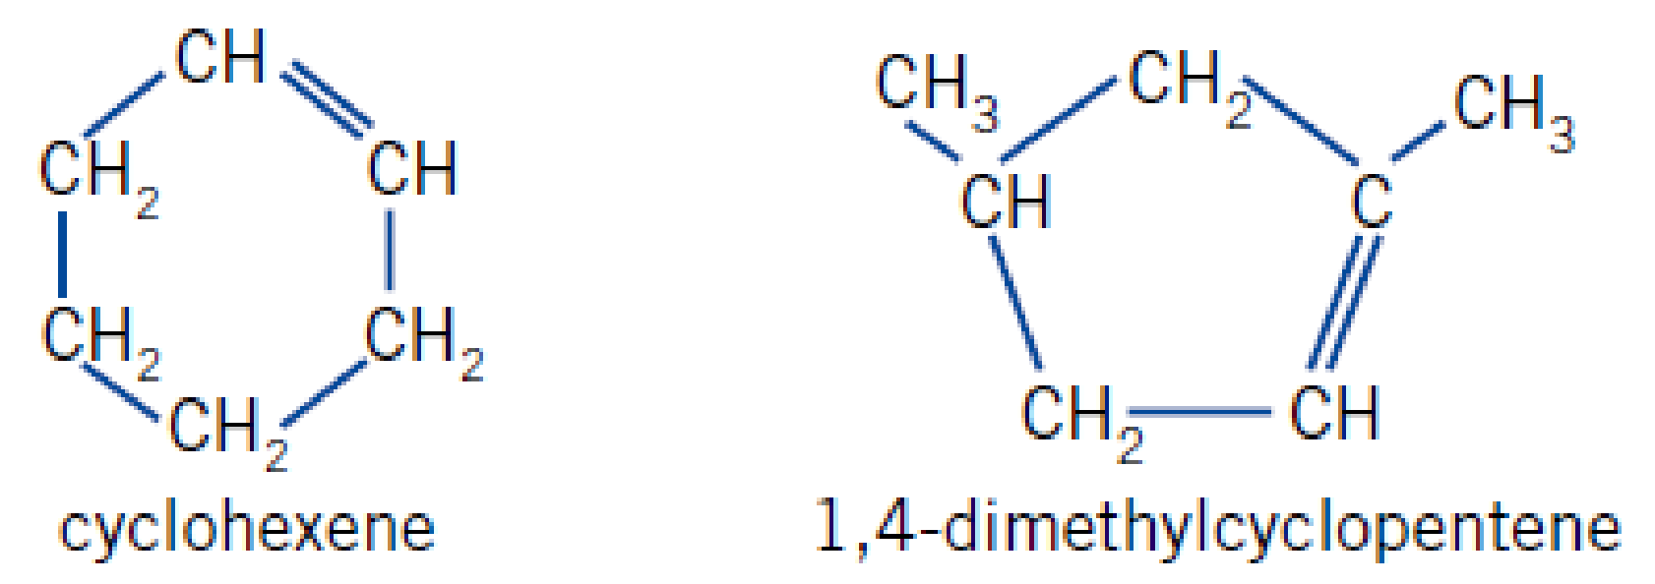
Alkenes – cylic alkenes
Name these cyclic alkenes:

Slide 13
Alkenes – physical properties
Similar trends as in alkanes. As molecular mass increases:
Melting and boiling point increases (C₂-C₄ are gases, C₅-C₁₅ are liquids C>16 are solids)
Density increases
Soluble in non-polar solvents (not in water)
Trans-cis forms have slightly different physical properties (as they have slightly different shapes

Slide 14
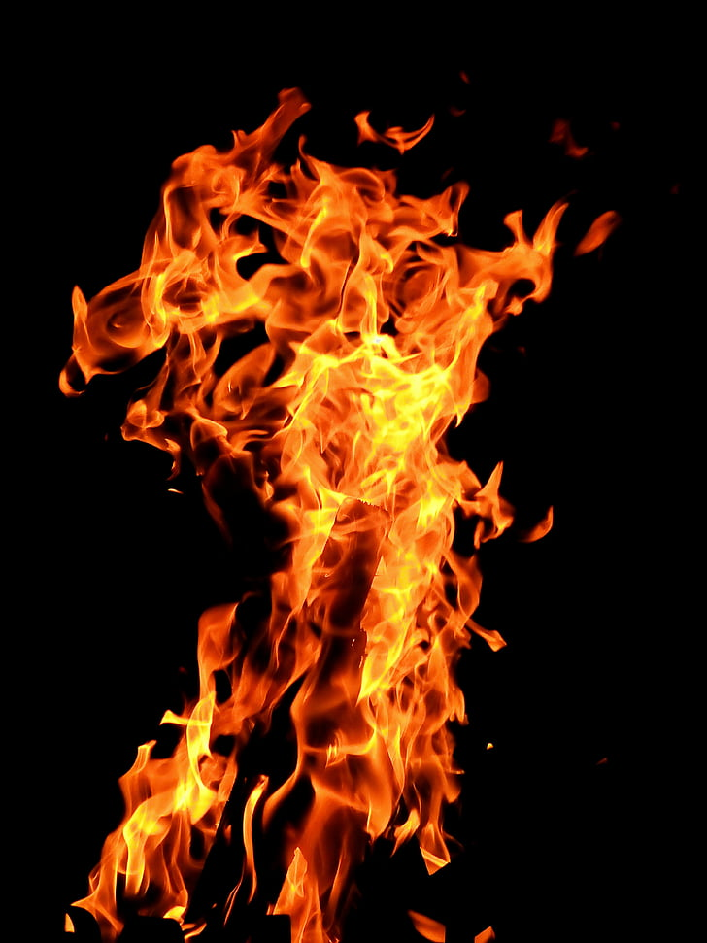
Alkenes - Reactions
Combustion Reactions – all exothermic (release energy)
Same products as alkanes
Complete combustion:
2 C₃H_{6(g)} + 9 O_{2(g)} 🡪 6 H₂O_{(g)} + 6 CO_{2(g)} + Energy
Incomplete combustion:
2 C₃H_{6(g)} + 6 O_{2(g)} 🡪 6 H₂O_{(g)} + 6 CO_{(g)} + Energy

Slide 15
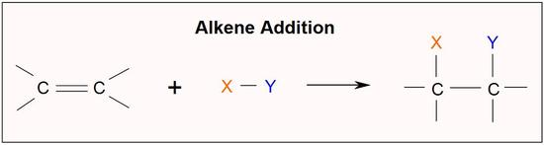
Alkenes - Reactions
Addition Reactions
C=C bond makes these reactions possible More reactive than alkanes
Two new atoms (or groups/chains of atoms) can join at the double bond creating two single bonds 🡪 become saturated compounds

Slide 16
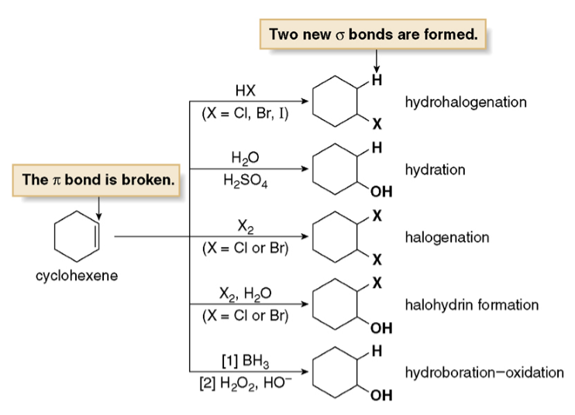
Alkenes - Reactions
Some examples of Addition reactions:

Slide 17
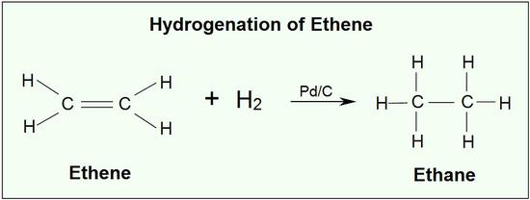
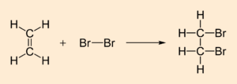
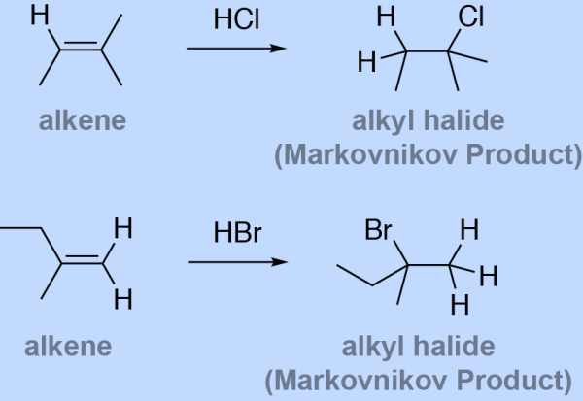
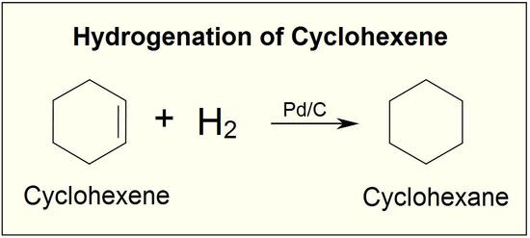
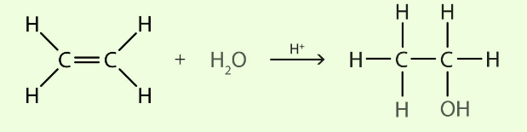
Alkenes - Reactions
Addition reactions you need to know are with hydrogen (H₂), halogens (Cl₂, Br₂, I₂), hydro-halides (HCl, HBr, HI) and water (H₂O)
1. Hydrogenation
2. Halogenation
3. Hydrohalogenation
4. Hydration

Slide 18
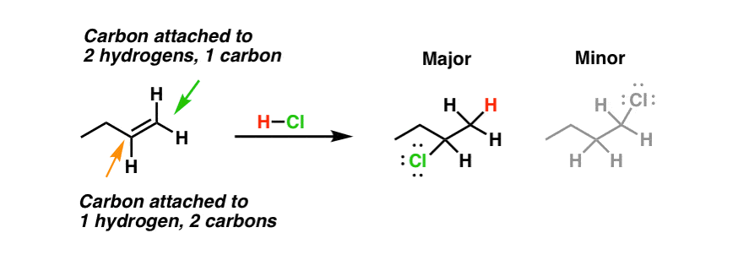
Alkenes - Reactions
Markovnikoff’s Rule
Hydrogen will bond preferentially to carbon which already has more hydrogen (i.e. the carbon on the end of the chain)

Slide 19
Alkenes – on going work
Complete the practice worksheet on naming and drawing alkenes
Pearson chapter review 8.2

